Slide 1
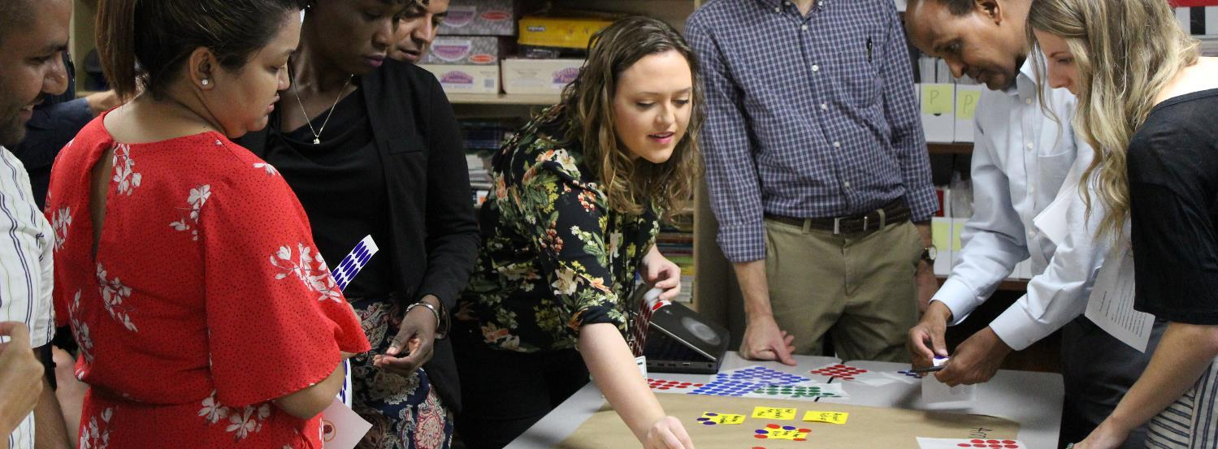
Activity: Cultural Orientation Message Delivery Role Play
Instructions: Practice integrating CORE materials into your everyday work.

Slide 2
Role Play 1 – Group of Five
Roles:
Refugee family
Caseworker
Interpreter
Scenario: Caseworker is helping a Congolese refugee family set up their phone. The caseworker has an interpreter and wants to show both husband and wife how to download and access the Settle In app.
Resources: Settle In, phone, Settle In palm card or flyer

Slide 3
Role Play 2 – Group of Three
Roles:
Refugee parents
Caseworker
Scenario: In a meeting with the caseworker, the refugee parent notes that they do not know how the child is doing at school. The caseworker takes this opportunity to show the client how watch the video from Settle In about Supporting Your Child in school.
Resources: computer or phone, Settle In Education video, and Settle In palm card or flyer

Slide 4
Role Play 3 – Group of Three
Roles:
Refugee
Caseworker
Interpreter
Scenario: Caseworker is conducting the initial orientation with a newly arrived refugee from Eritrea using an interpreter.
Caseworker wants to review with the refugee the Reception and Placement video from Settle In to give them an overview.
Resources: Computer or phone, and Settle In R&P video or fact sheet (note that the video/audio and fact sheet contain the same text, which allows for flexibility depending on client literacy level)

Slide 5
Role Play 4 – Pairs
Roles:
Caseworker
Single mother, some English
Scenario: The caseworker is conducting a 30-day home visit and notices that the refugee is not keeping their home clean. The caseworker takes this opportunity to review information about hygiene in the home using the Hygiene fact sheet.
Resources: computer or phone, and Settle In Hygiene fact sheet (note that the video/audio and fact sheet contain the same text, which allows for flexibility depending on client literacy level)

Slide 6
Role Play 5 – Pairs
Roles:
Employment
Refugee
Scenario: The SIV-holder from Iraq has obtained their first job. They are excited about receiving their paycheck and ask the employment staff member about buying a car. The employment staff member wants to take this opportunity to review budgeting and finance using CORE’s resources.
Resources: computer or phone and Settle In Money Management audio or fact sheet (note that the video/audio and fact sheet contain the same text, which allows for flexibility depending on client literacy level)

