Slide 1
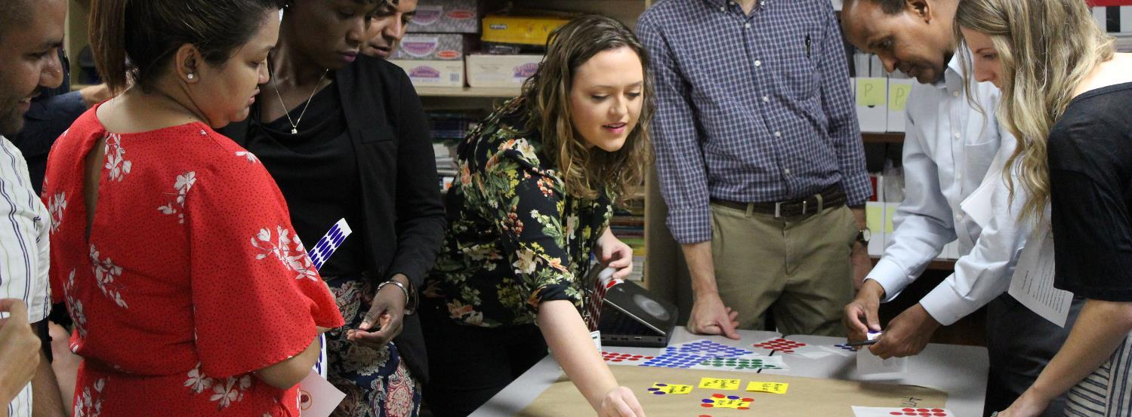
Activity: Journey Mapping
Instructions: We will look at the major events of the refugee resettlement process and consider where a refugee might ask questions related to key CO messaging. For this activity we will use the annotation tool.

Slide 2
Meet Honorine …
Age: 38
Country of Origin: Democratic Republic of Congo
Pre-Departure Location: Rwanda
Case Details: Single mother, two children aged nine and six
Health Status: Children are in good health; Honorine minor health concerns
Language Spoken: Kinyarwanda
Literacy Level: Low literacy
Education Level: Partial primary school; children receiving limited schooling
Areas of Concern: Employment, education for her children, housing

Slide 3
Arrival
Housing Orientation
Use the annotation tool to mark where Honorine would ask the following questions.
24-Hour Home Visit
Apply for SSC
Who will find me a job? = Star
New Client Intake
Apply for SNAP
Who will take care of my children if I am working? = Heart
Other Public Assistance Applications
Transportation Orientation
ESL Enrollment
CO Classes
School Enrollment
Health Screening
SSN Received
30-Day Home Visit
Budget Created
EAD Received
PCP Appointment
CO Classes
It’s expensive in the U.S. Who will pay for my housing? = Check
Obtains 1st Job
How do I talk to the teacher if I do not speak English? = X
90 Days

